Slide 1
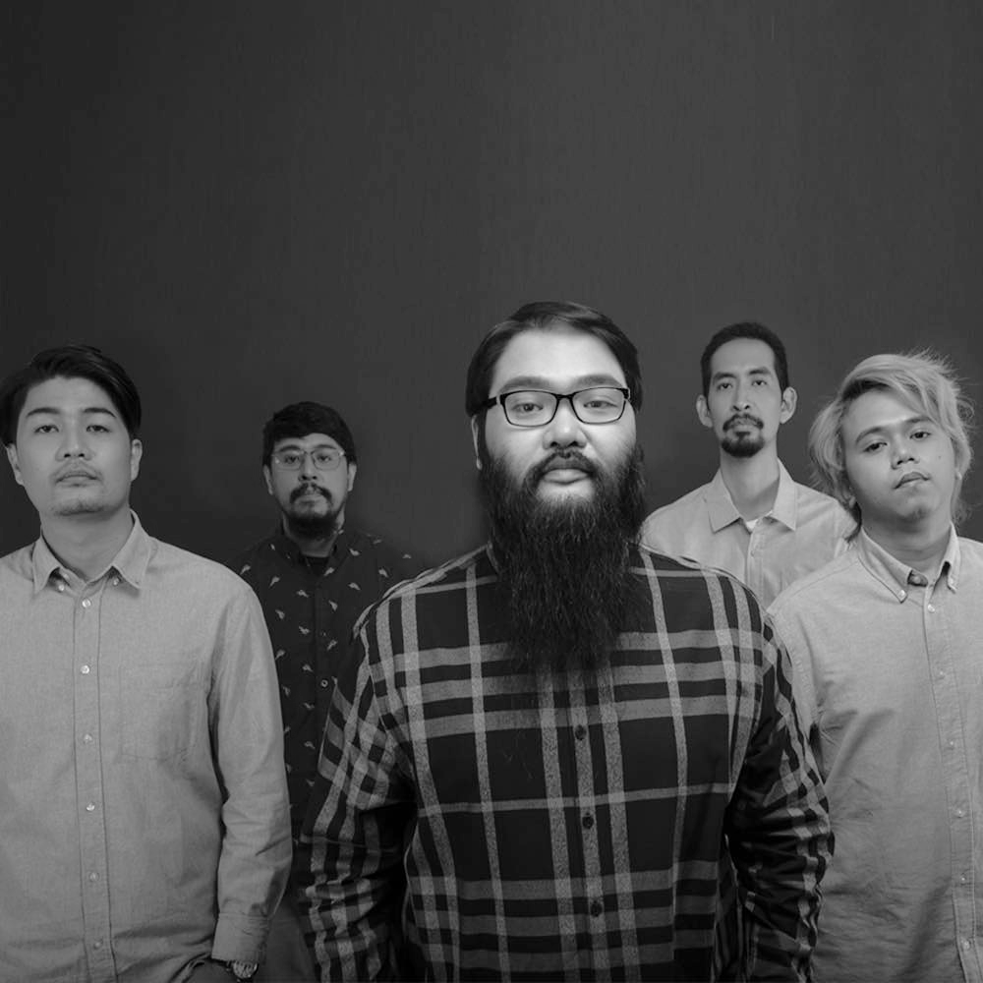
I BELONG TO THE ZOO:
I BELONG TO THE TOP
The next big OPM band
Andre D. | Andre P. | Enrico | Iggy | Karla | Mike

Slide 2
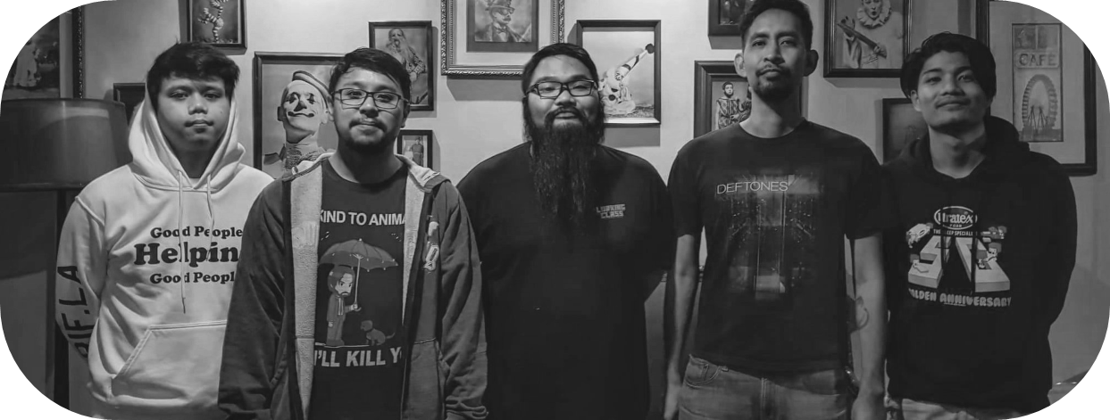
I BELONG TO THE ZOO
Filipino indie pop rock band that became active on 2014
Became a five piece band after their first album I Belong to the Zoo
Became popular, mainly because of their hits Sana on June 2018 and Balang Araw on October 2018 (4th Wish 107.5 Music Awards)
Notes:
Essay: Once started as a solo project by Argee Guerrero, the Filipino Indie pop rock band became active on 2014. After the success of the first album with the same name, the band expanded to a five piece band. Their popularity skyrocketed on their release of their single Sana on June 2018 and Balang Araw 2018, which even won them an award. That was back in 2018, so how are they now?

Slide 3
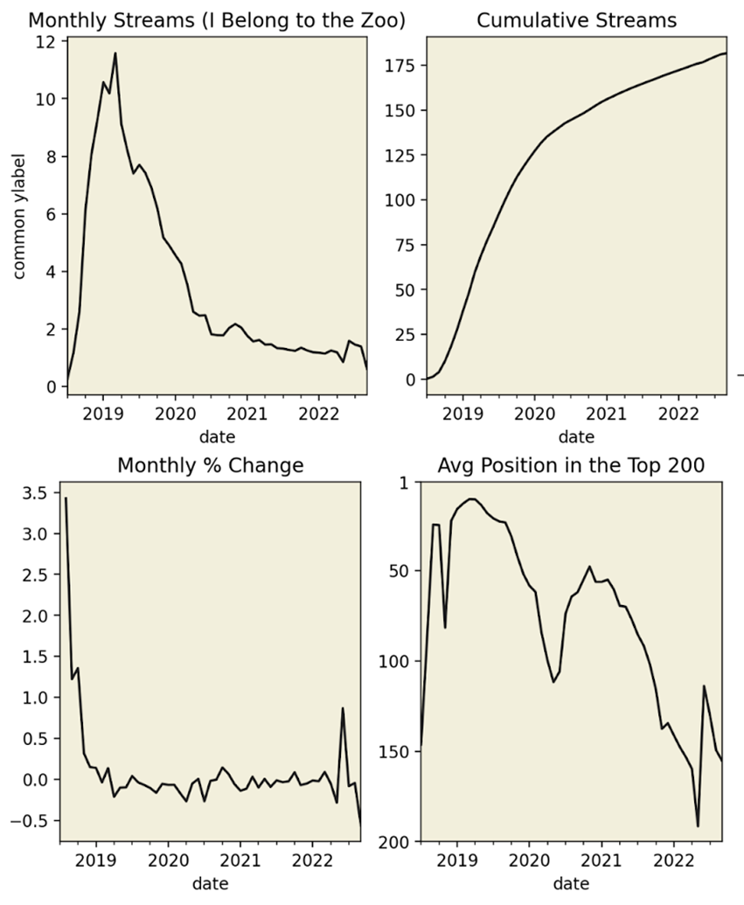
Recent Struggles after their Initial Hits
Streams peaked in 2019
Only 2 songs charted
Sana
Balang Araw
Sharp decrease in monthly streams and average position
Notes:
Transition from previous slide-> End with mentioning the hits, it turns out that after their hit songs, that was their peak already, which brings to question

Slide 4

HOW CAN WE HELP I BELONG TO THE ZOO REACH THE TOP OF THE CHARTS AGAIN?
Notes:
Which brings up the question, *read*
We can start answering this by observing their hit songs

Slide 5
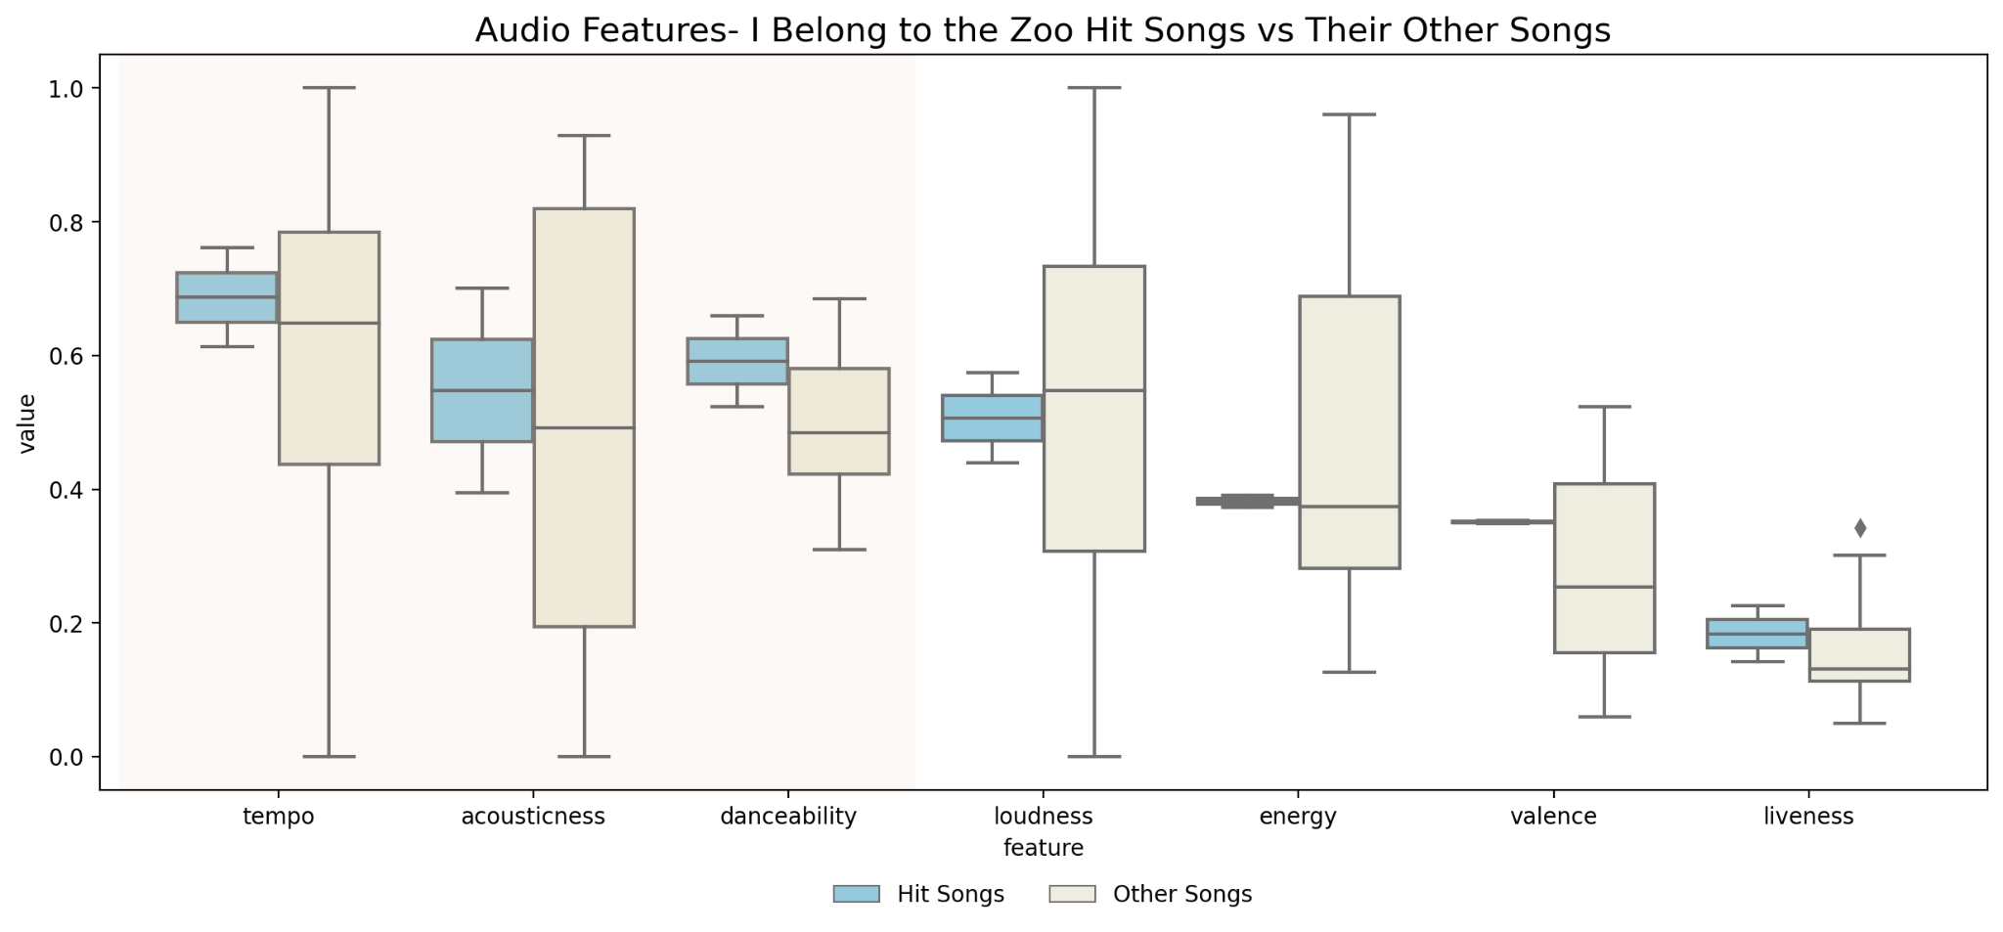
How Did they Come up with Hits Before?
Their previous hits were:
High tempo
Acoustic
Danceable songs
Notes:
The first thing we did was to revisit their previous success, since they’ve been there before. What was their formula for generating previous hits?
Their hits had high tempo, were more acoustic, and more danceable.

Slide 6
BUT DOES THIS FORMULA STILL WORK IN TODAY’S MARKET?
What type of OPM music do people listen to these days?
Which artists are dominating today’s charts?
Notes:
But the question is, does it still work in today’s market. To find out, we did a market study.

Slide 7


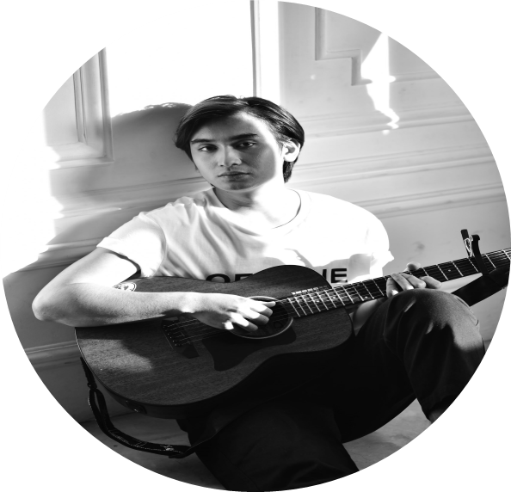
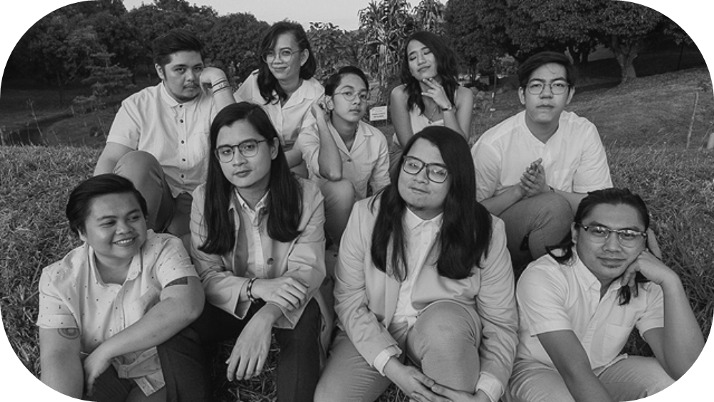

OPM MAINSTAY ARTISTS
Zack Tabudlo
Nobita
Artists with the most mainstay tracks
Mainstay tracks:
Top 15th percentile of appearances in Top 200
Average position is in the top 25% of the Top 200
Adie
Ben & Ben
Arthur Nery
Notes:
Mention that for labelling purposes, we grouped these 5 artists into 2 Groups:
Big3 (Young Solo Male Artists) -> Zack, Adie, Arthur
Dominant Bands (Ben&Ben and NOBITA)

Slide 8
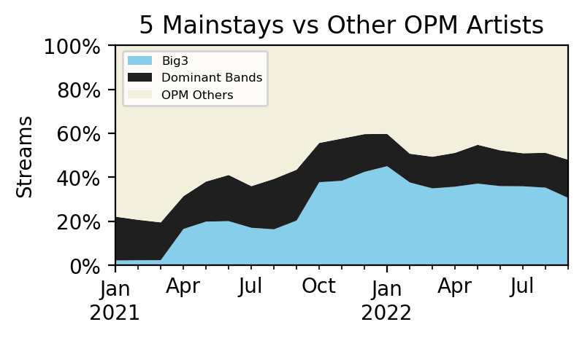
OPM Artists Stream Chart
-Mainstay artists take up about 50% of the total streams
Notes:
Here is a chart to show how dominant these 5 artists are in today’s market. They take up half or 50% of the total streams from all OPM Artists.

Slide 9

WHAT CAN WE LEARN FROM THESE MAINSTAY ARTISTS?
SONG COMPOSITION
Notes:
To find out, we did a market study.
Times are changing, there could be something better we can do in terms of :

Slide 10
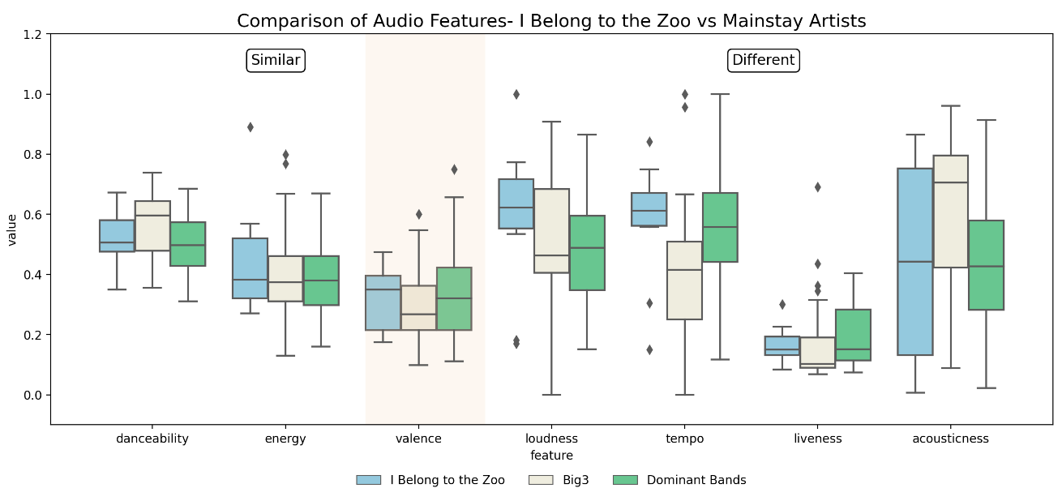
Song Composition- Comparison of Audio Features
-Valence distribution is similar to mainstay artists
-This remains an effective approach to get streams
-I Belong to the Zoo is doing the right things in terms of composing lyrics and creating sad content for their songs.
Notes:
Discuss process-> Top 10 Tracks of IBTTZ, Big3, and 2 Dominant bands
Discuss that left side are the ones with similar audio features, and the right side (highlighted portion) is the one with different ones. Redirect audience to highlighted part because are recommendations for the song composition will depend on this.
Audio Features Boxplot Insights
Try slower tempo, and lower volume (less loud) songs to make the listeners feel the “hugot” more
Create more live tracks, very important for bands to have a solid audience following

Slide 11
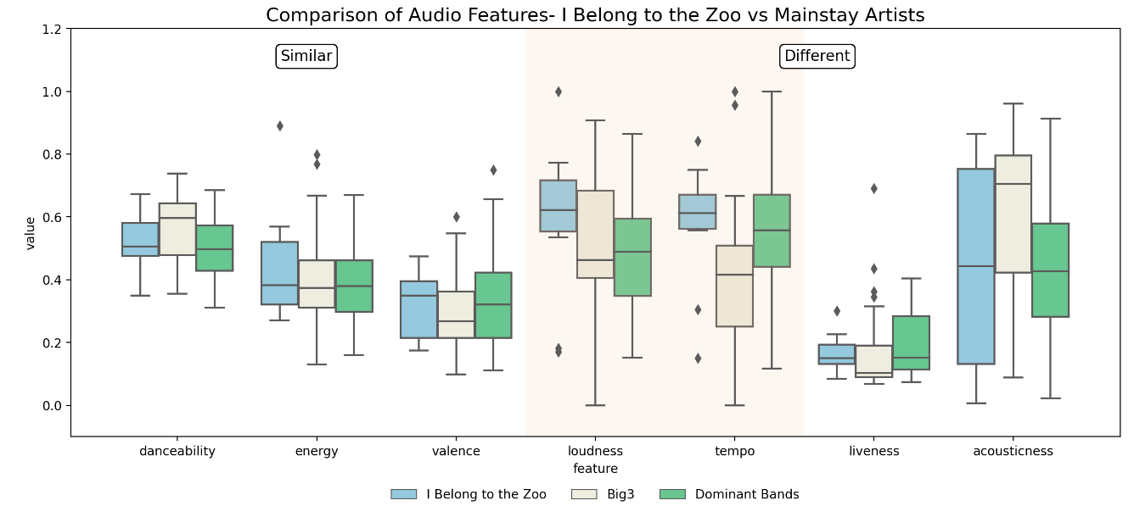
Song Composition- Comparison of Audio Features
-Improvements can be made with how they deliver the message
-Current Tracks of I Belong to the Zoo are louder have faster tempos
-Try releasing tracks that are slower and more “quiet” since these could be more effective in evoking the listeners’ emotions
Notes:
Discuss that left side are the ones with similar audio features, and the right side (highlighted portion) is the one with different ones. Redirect audience to highlighted part because are recommendations for the song composition will depend on this.
Audio Features Boxplot Insights
Try slower tempo, and lower volume (less loud) songs to make the listeners feel the “hugot” more
Create more live tracks, very important for bands to have a solid audience following

Slide 12

WHAT CAN WE LEARN FROM THESE MAINSTAY ARTISTS?
PROMOTIONAL/MARKETING STRATEGIES
Notes:
To find out, we did a market study.
Times are changing, there could be something better we can do in terms of :

Slide 13
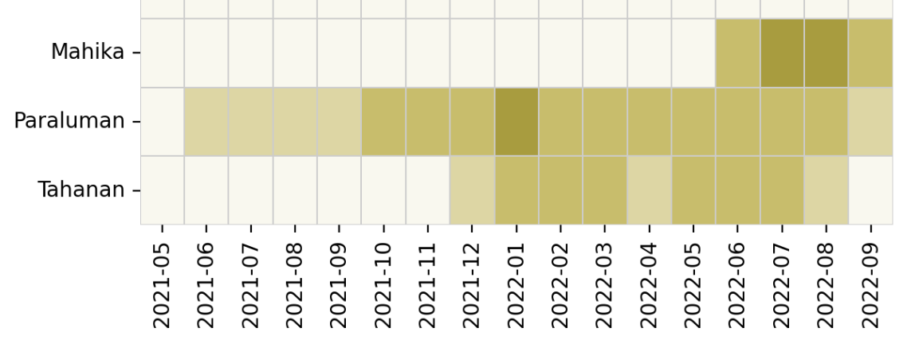
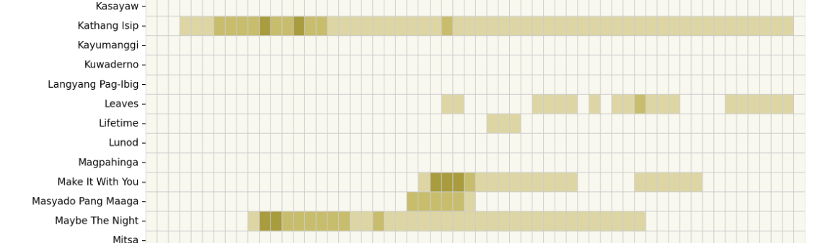
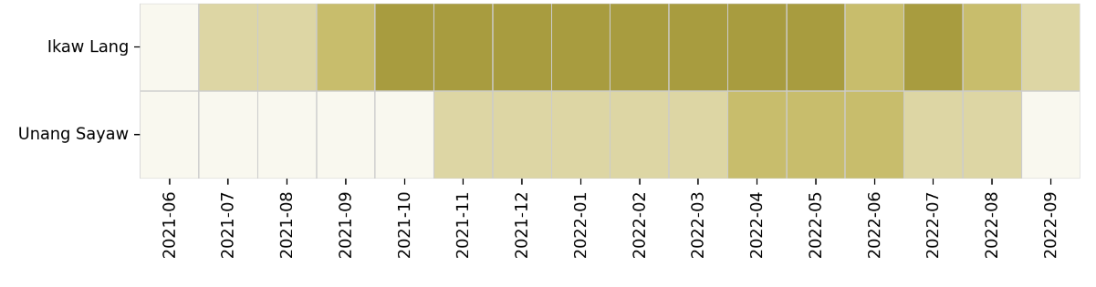
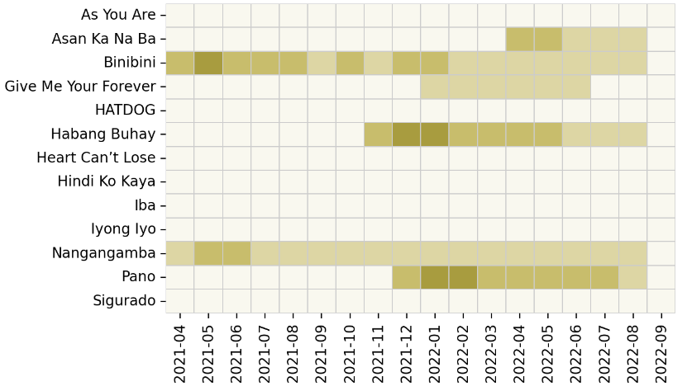
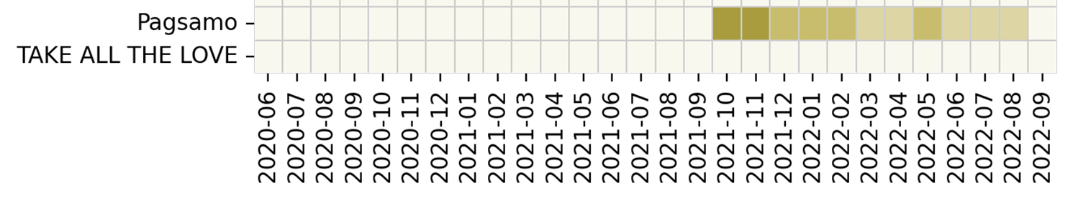
Marketing Strategies of Mainstay Artists
ADIE
BEN & BEN
ZACK TABUDLO
NOBITA
ARTHUR NERI
Notes:
We Studied Heatmaps and what happened on the dark days. The darker the color, the larger the amount of streams had occurred on that specific month.
We researched which promotional strategies mainstay artists used on these months to promote their tracks, to generate a huge amount of streams.

Slide 14
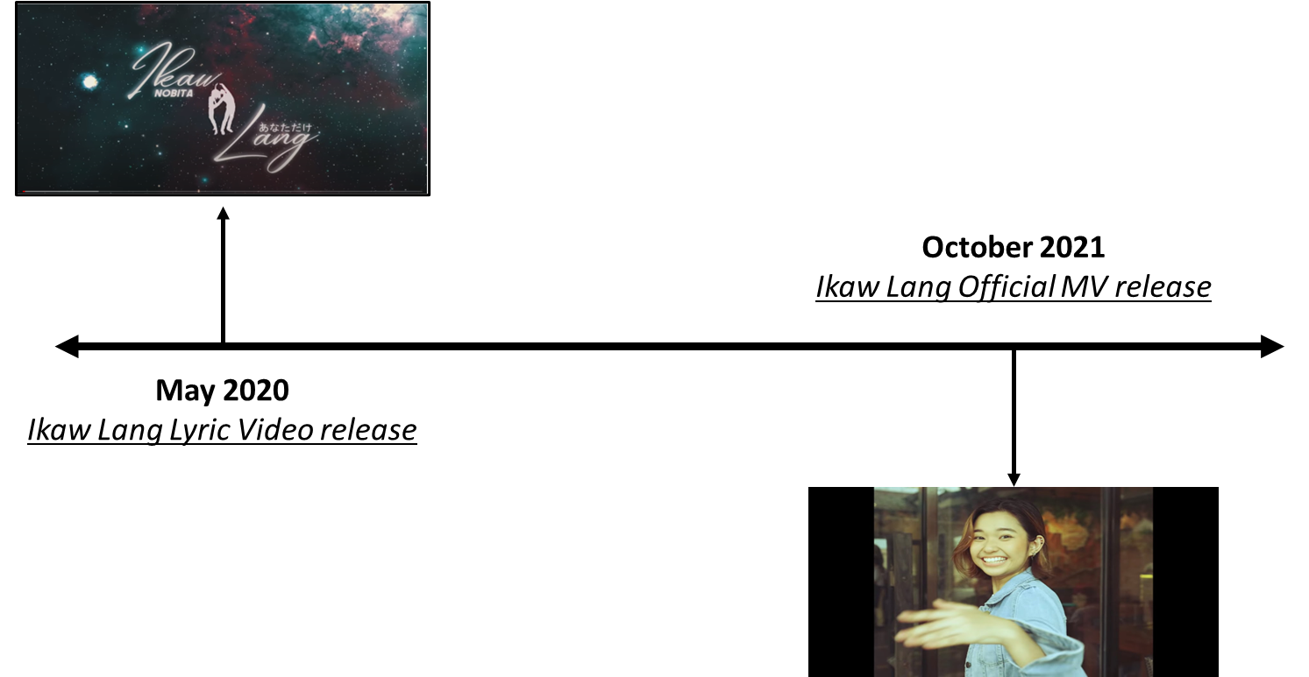
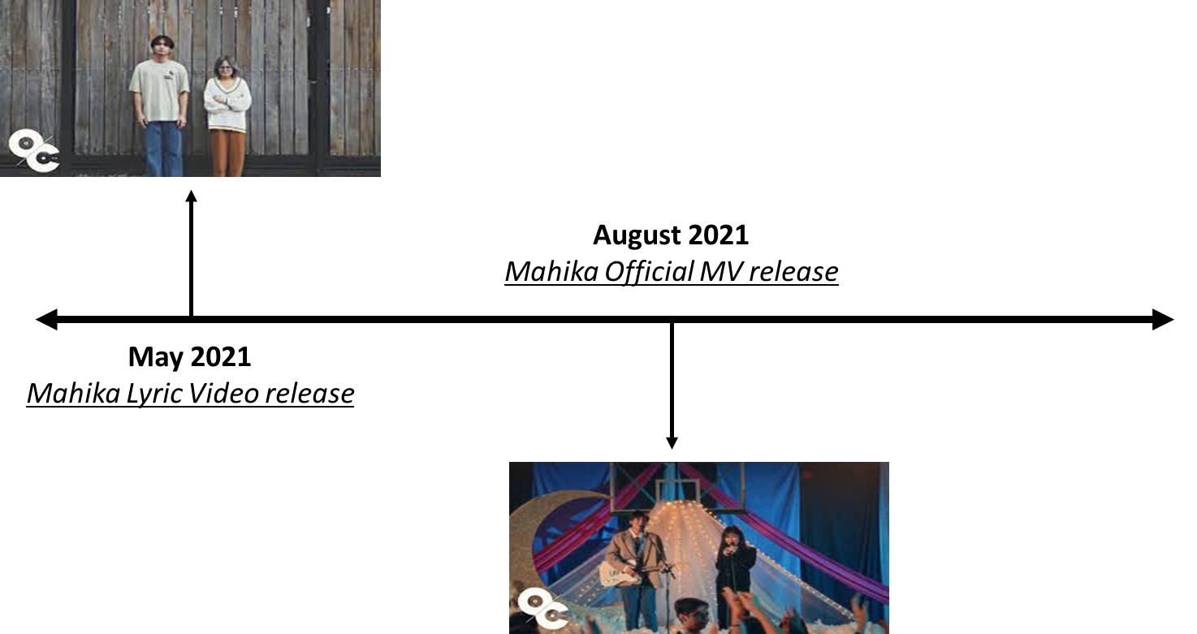
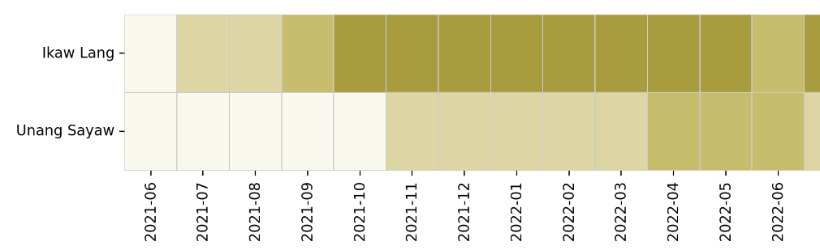
Marketing Strategies of Mainstay Artists:
Strategic Release/Timing of Music Videos
Notes:
For this part and the next 3 slides (Marketing Recos) we can
Discuss What the Mainstays din (explain pictures)
Then Recommend what I Belong to The Zoo can do

Slide 15
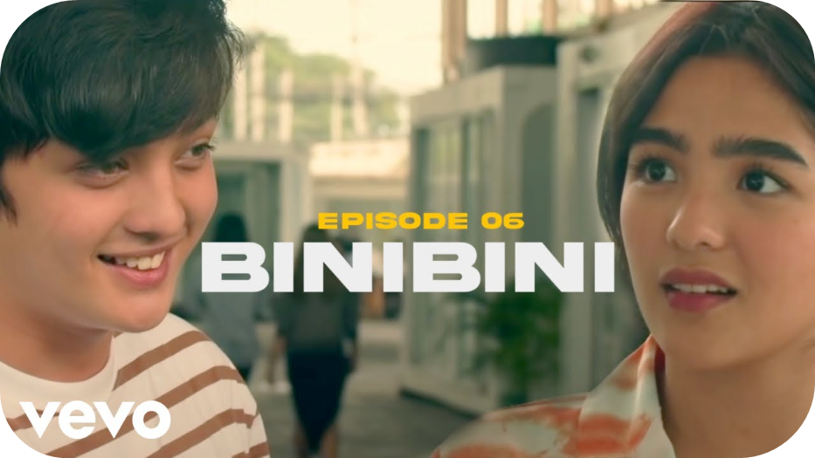
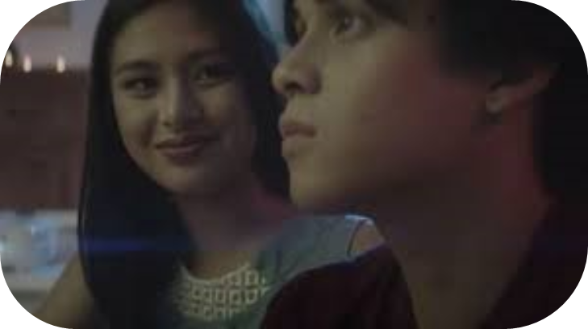
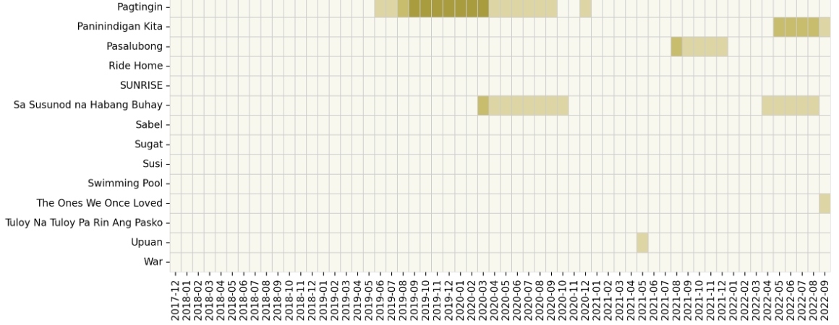
Marketing Strategies of Mainstay Artists:
Collaboration with famous actresses/actors in music videos
April 2021 - August 2022
July 2019 to March 2020
PAGTINGIN MV
Notes:
E.g.

Slide 16
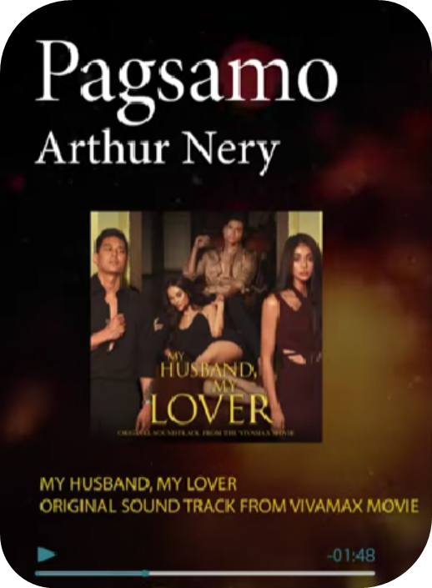
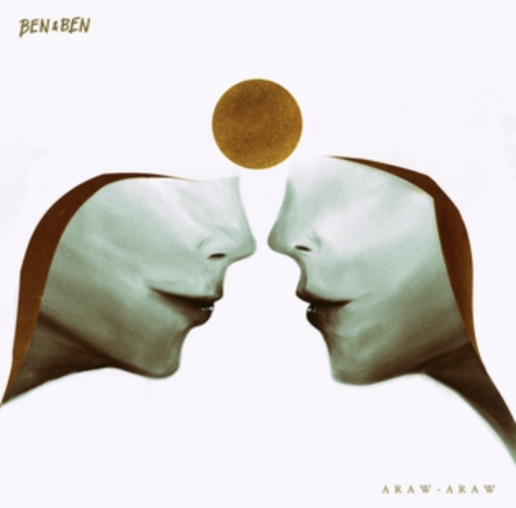
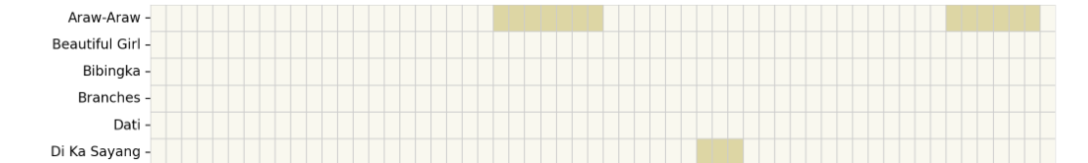
Marketing Strategies of Mainstay Artists:
Movie/Teleserye Soundtracks
Nov 2021
July 2019 onwards

Slide 17
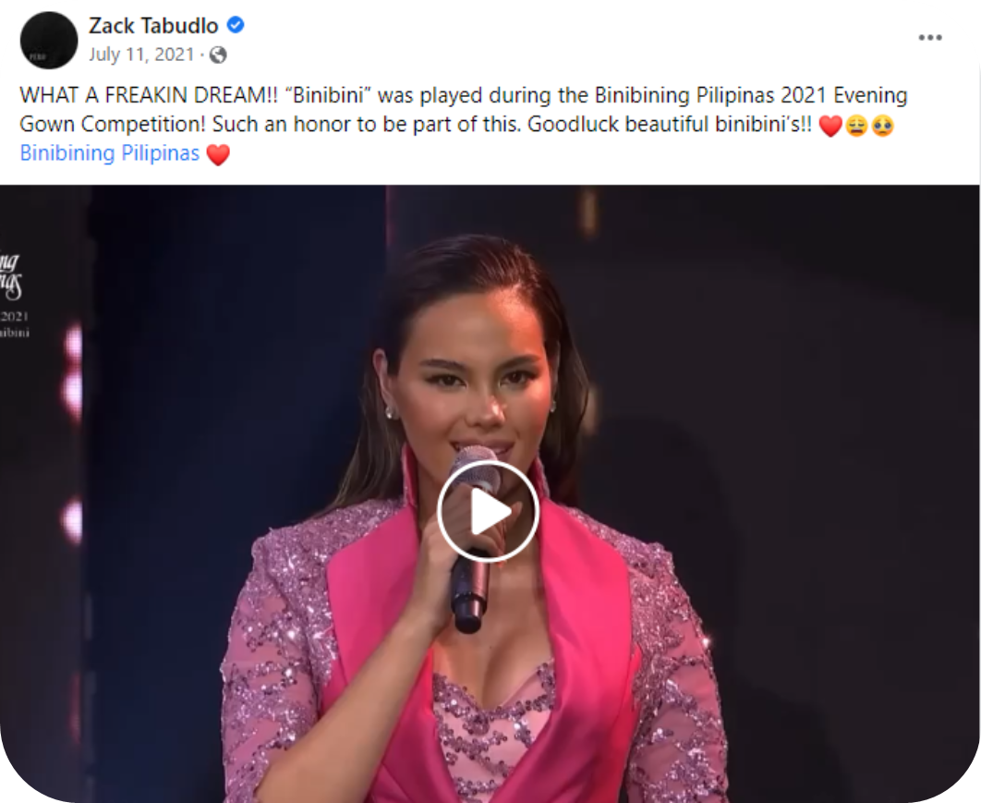
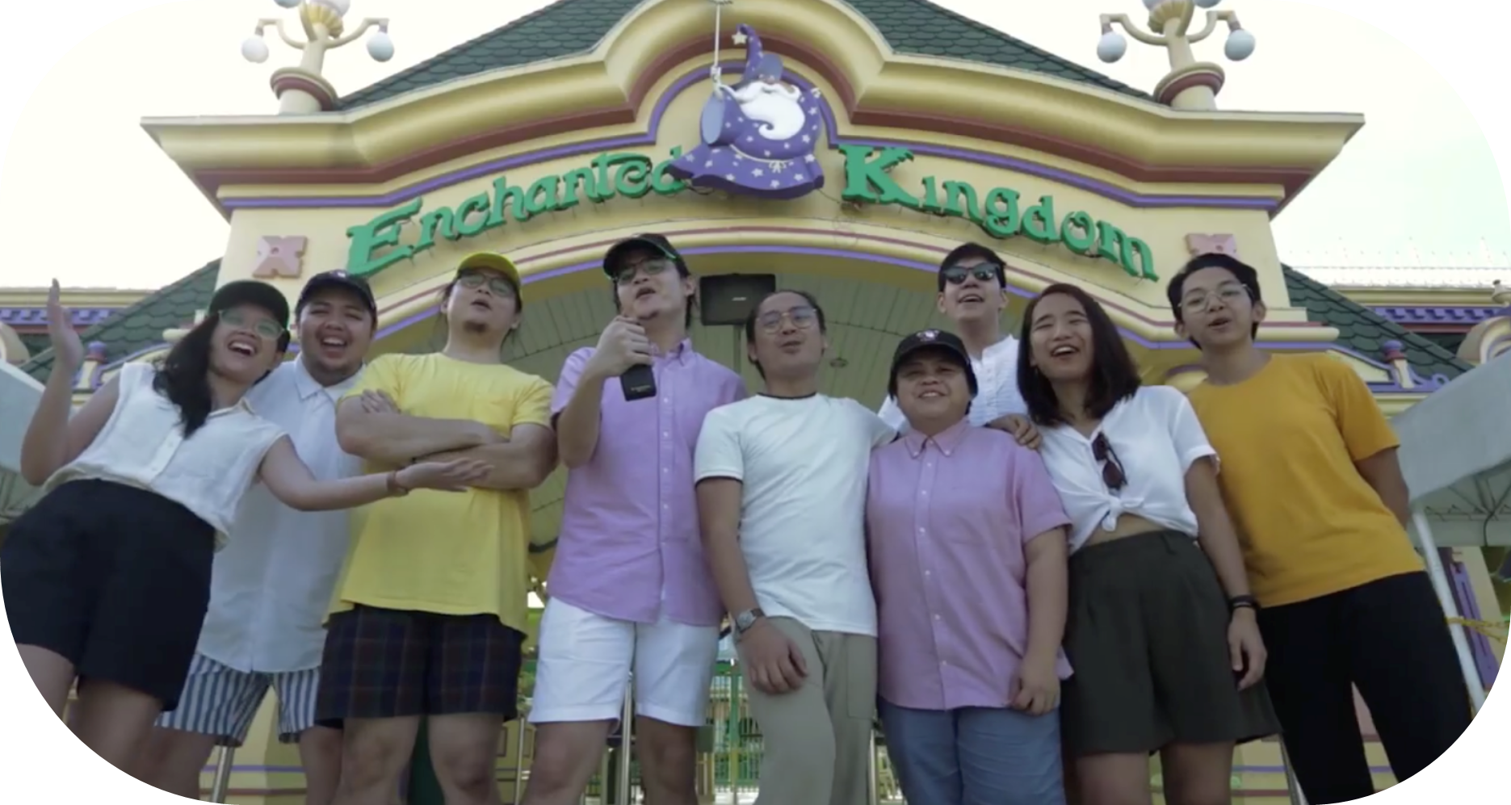
Marketing Strategies of Mainstay Artists:
Live Performances/Exposure in Important Events
July 2021
BINIBINI
July 2019 to March 2020
PAGTINGIN

Slide 18
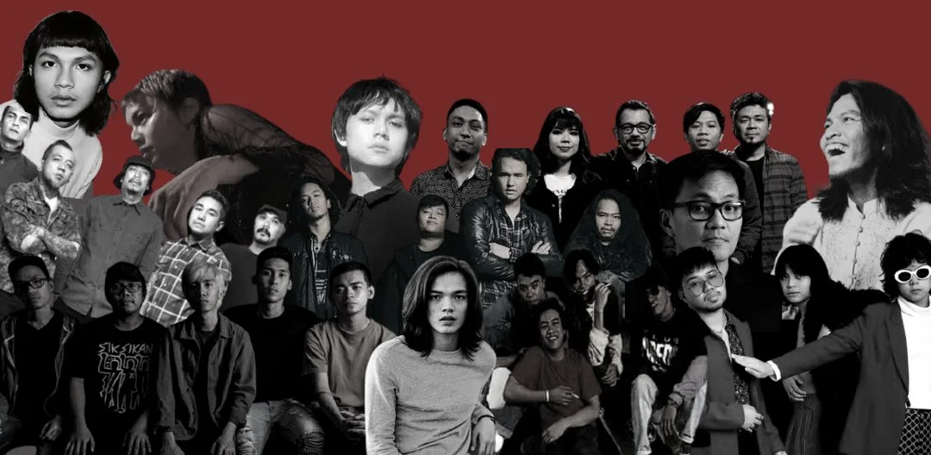
Who else belongs to the zoo?
Collaboration with other OPM artists
Notes:
Who else belongs to the zoo? We created a recommender engine to address this.

Slide 19
ML data pipeline for genre classification and recommender engine playlist generation
INPUT
Feature Engineering
Genre Classification
Model Training
Model Selection
OUTPUT
OPM Tracks data
Scaling
KNN
Genre Label Encoding
Model metrics
SVM
Genre tag per track
Recommendation Pool
Scaling
Best Model
Representative Track
Recommender engine
Scaling
Recommended tracks and artists

Slide 20
Build a genre classification model
Tested Models
Genre: OPM Dance, OPM Acoustic, OPM Jazz, OPM Rock]
Features: danceability, energy, acousticness, valence
Best model: SVM (radial, C=10, gamma=1) accuracy: 68%
Genre: OPM Acoustic, OPM Indie, OPM Rock, OPM Reggae, OPM Rap
Features: danceability, energy, acousticness, valence, speechiness
Best Model: SVM (polynomial kernel, C=1000, gamma=1)
Accuracy: 55%
Genre: OPM Dance, OPM Acoustic, OPM Jazz, OPM Rock
Features: danceability, energy, acousticness, valence
Best model: SVM (radial, C=10, gamma=1) accuracy: 68%
Genre: OPM Acoustic, OPM Indie, OPM Rock, OPM Reggae, OPM Rap
Features: danceability, energy, acousticness, valence, speechiness
Best Model: SVM (polynomial kernel, C=1000, gamma=1)
Accuracy: 55%

Slide 21
Classified OPM sub-genres: Rock, Rap, Reggae, Jazz, Dance, Acoustic
Audio features: Danceability, energy, acousticness, valence, speechiness
SVM Radial Kernel was selected as the best model with highest accuracy rate.
KNN (K Neighbors = 42)
57%
SVM (Linear Kernel)
60%
SVM (Polynomial Kernel)
61%
SVM (Radial Kernel)
63%
Notes:
For better classification, we have chosen subgenres of OPMs: Rock, Rap, Reggae, Jazz, Dance, and acoustic so it would only include Filipino artists.
For features: we included Danceability, energy, acousticness, valence, speechiness.
Ultimately, we have chosen SVM radial kernel among the the other models that we have tested.

Slide 22

Build a genre classification model
Chosen model: OPM Genres:
Rock, Rap, Reggae, Jazz, Dance, Acoustic
Audio features as basis for training:
Danceability, energy, acousticness, valence, speechiness
Support Vector Machine (SVM) Algorithm
Parameters: Radial kernel, gamma = 1
63% Accuracy

Slide 23
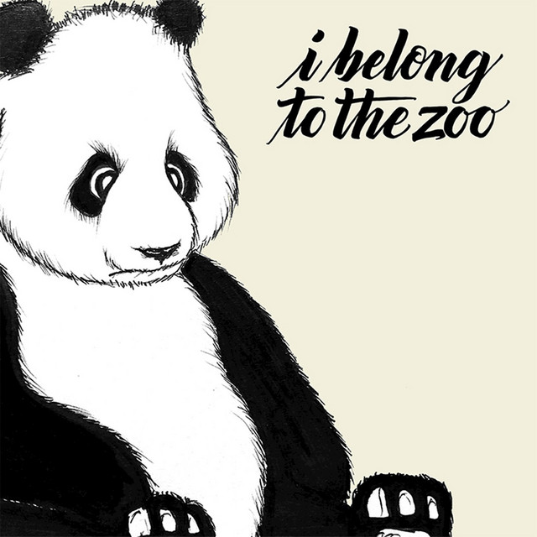
Create representative track
OPM MAINSTAY ARTISTS
Representative track is the median of a playlist containing audio features of top songs by OPM Mainstay artists and I Belong To The Zoo
Similarity with other OPM charting songs using cosine distance of audio features and predicted genre probabilities.
Cosine distance range (Distance): [0.00771-0.01844]
Notes:
Now that we have the classification model set up, we then created a representative track as a point of reference to find similar songs.
The representative track we made was based on the median audio features of aggregated top songs of OPM Mainstay Artists and our band, I Belong To The Zoo.
This was chosen to incorporate features of what we classified as mainstay songs, while still retaining the authentic musicality of our band.

Slide 24
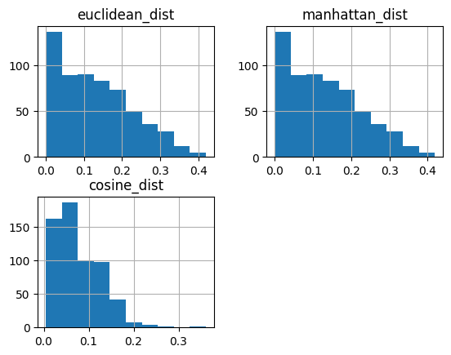
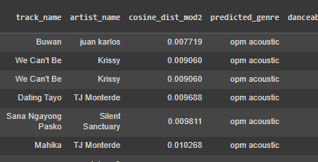
Find similar songs
Tested approaches
Explored similarity measures:
Euclidean
Manhattan
Cosine - Most points with smallest distance
Modified similarity criteria:
Audio features and with same predicted genre
Predicted genre probabilities
Audio features and predicted genre probabilities

Slide 25
Find similar songs
Similarity Criteria: audio features and predicted genre probabilities
Similarity measures:
Euclidean
Manhattan
Cosine - Songs with closest distance
Notes:
We then looked for similar songs from a recommendation pool of OPM songs that has reached the Top 200 charts for the past five years.
We compared the similarity of two factors: the songs’ audio features, and their predicted genre probabilities.
We tested three different approaches to measure similarity: Euclidean distance, Manhattan distance, and Cosine similarity. Looking at the histogram of each, the cosine distance produced points with the smallest distances. We then chose this as the criteria to measure similarity, and proceeded to finding the most similar songs.

Slide 26
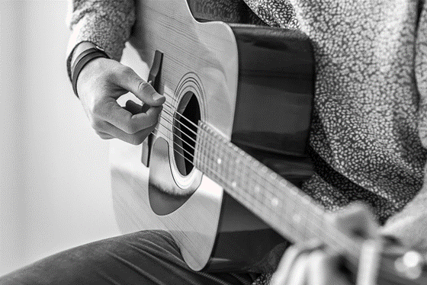
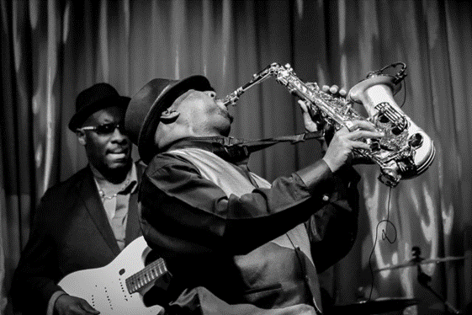
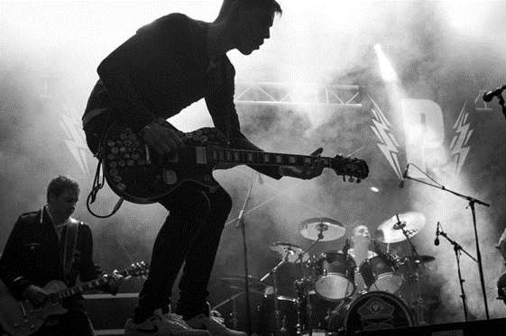
Acoustic
Jazz
Rock
We found three recurring genres with greatest similarity.
Notes:
After running our recommender engine, we found three recurring predicted genres with the greatest similarity to our representative track, and these are Acoustic, Jazz, and Rock.
For each of this genre, we then chose the top 5 songs with the greatest similarity to the representative track, and came up with a list of recommended artists.

Slide 27

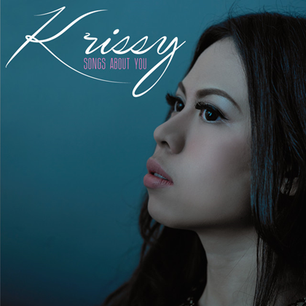

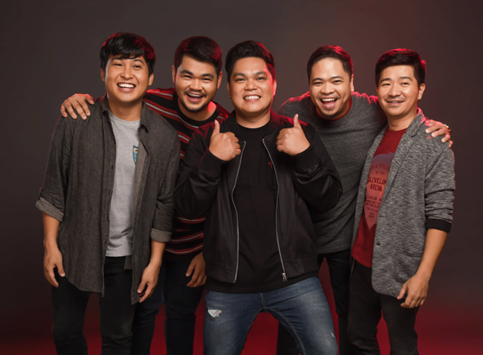
Recommended Artists (Acoustic)
Juan Karlos
Krissy
Distance: 0.00771872
Distance: 0.009060213
TJ Monterde
Silent Sanctuary
Distance: 0.009688
Distance: 0.009811
Notes:
Cosine distance Juan Karlos: 0.00771872
Krissy: 0.009060213
TJ Monterde: 0.009688
Silent Sanct: 0.009811

Slide 28
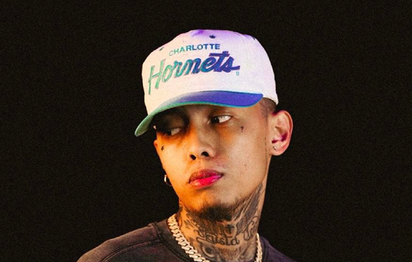

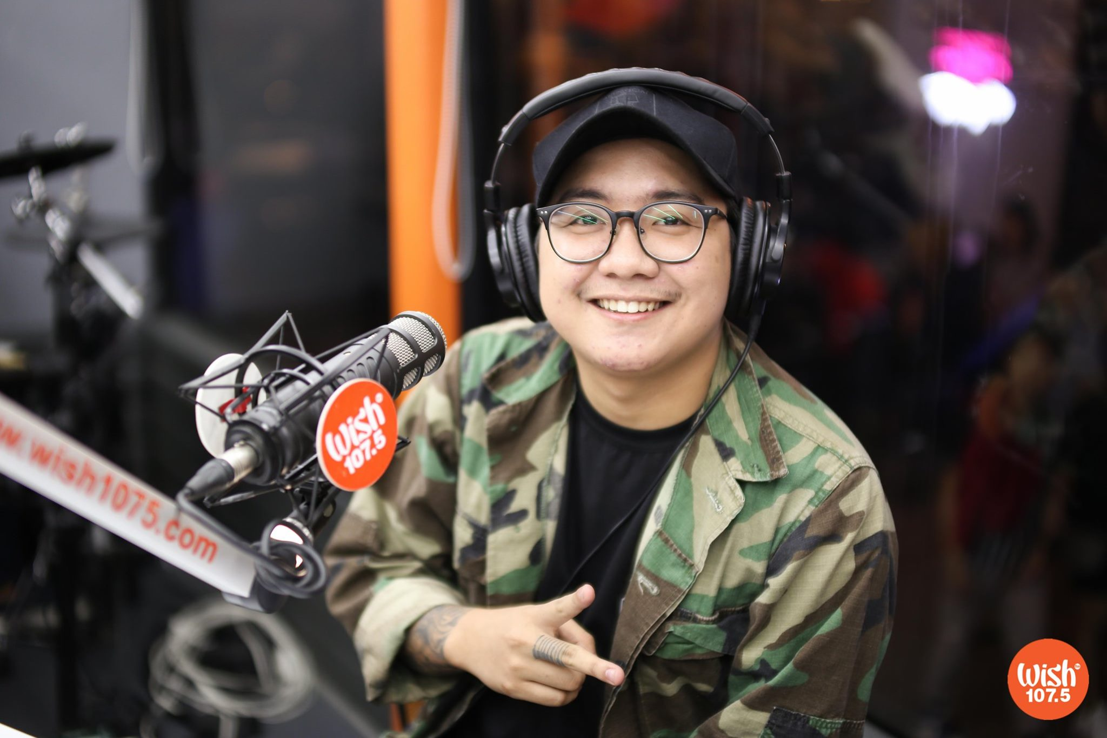

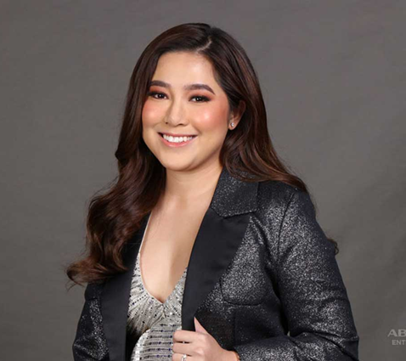
Recommended Artists (Jazz)
Skusta Clee
Belle Mariano
John Roa
Distance: 0.018834
Distance: 0.018834
Distance: 0.029866
MYMP
Moira Dela Torre
Distance: 0.037652
Distance: 0.019004
Notes:
Cosine distance Skusta Clee: 0.018834
Belle Mariano - 0.036579
John Roa - 0.029866
Mymp - 0.037652
Moira Dela Torre - 0.019004

Slide 29
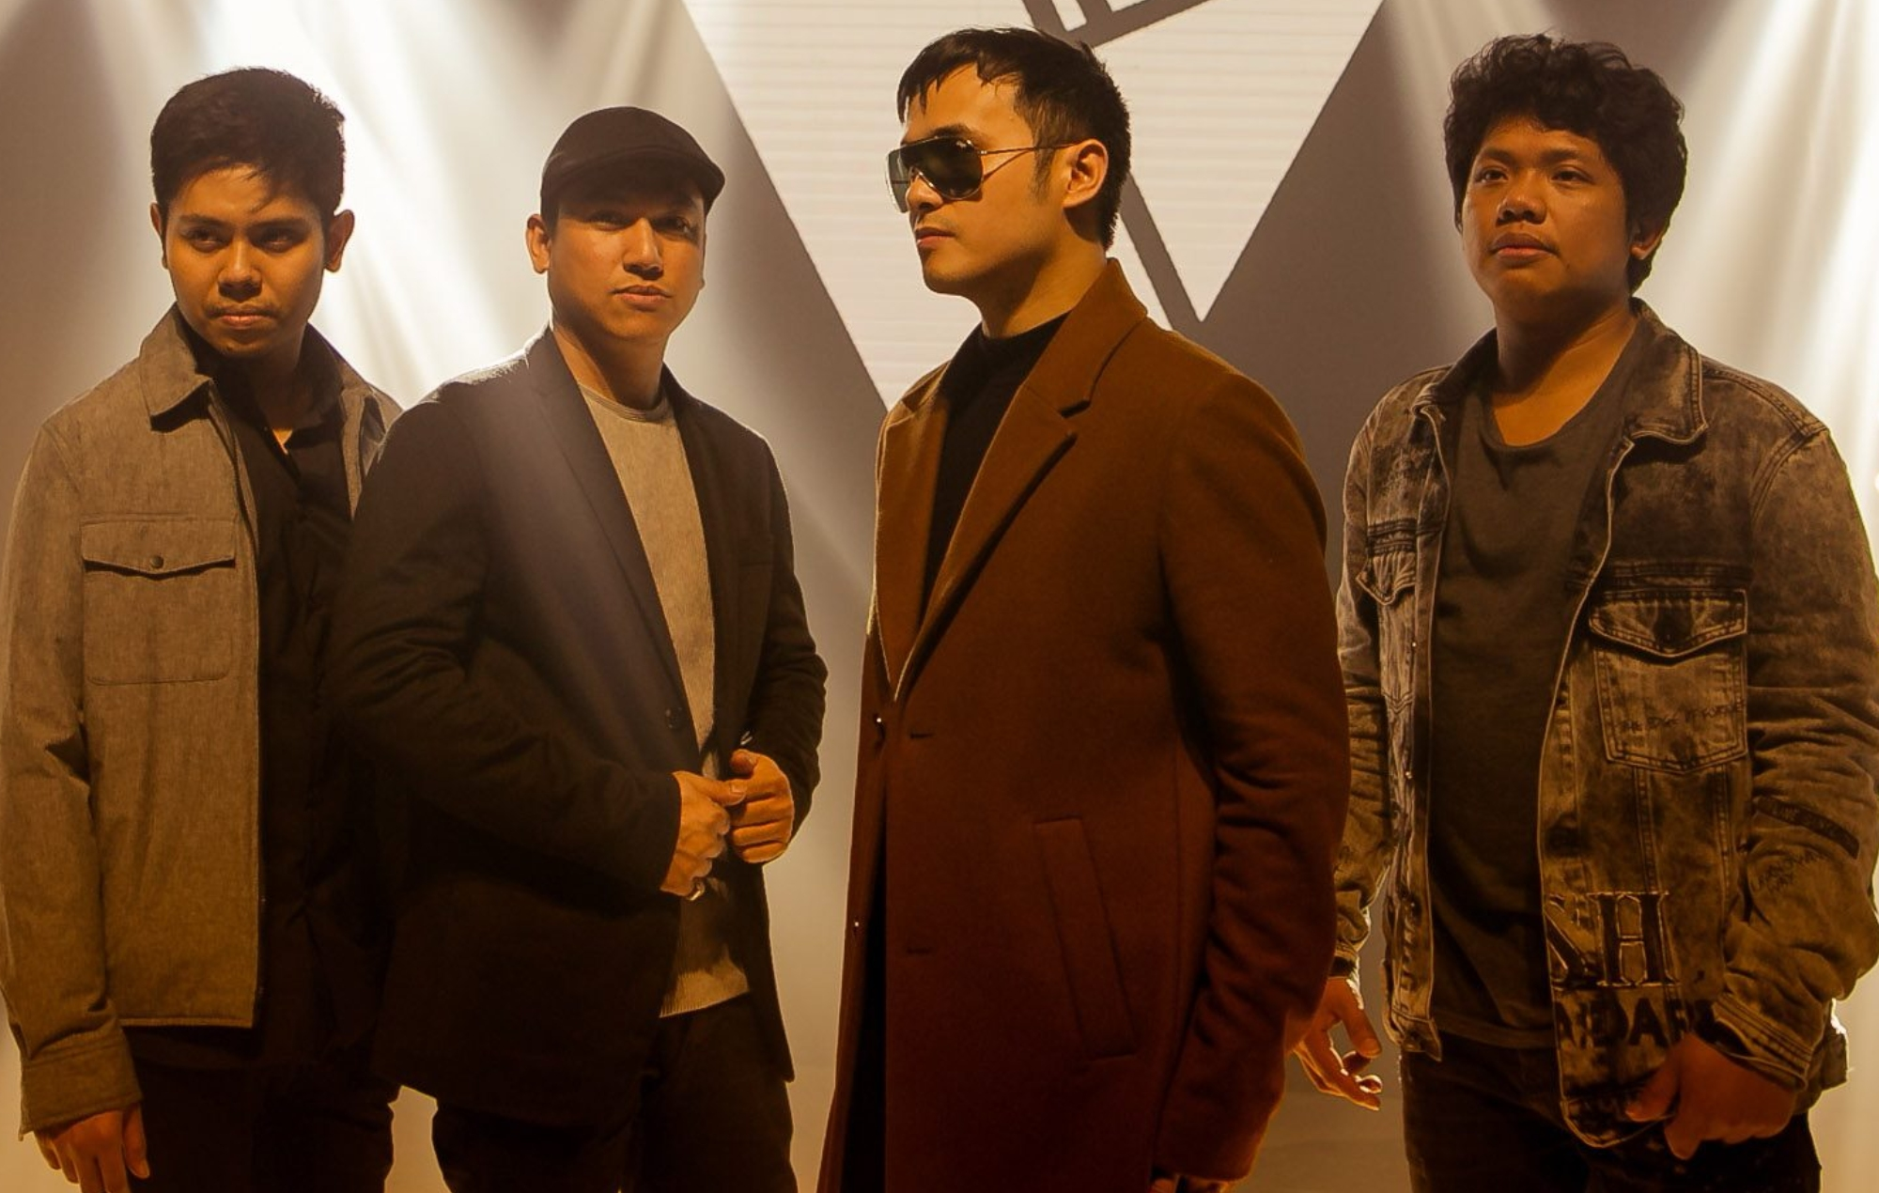
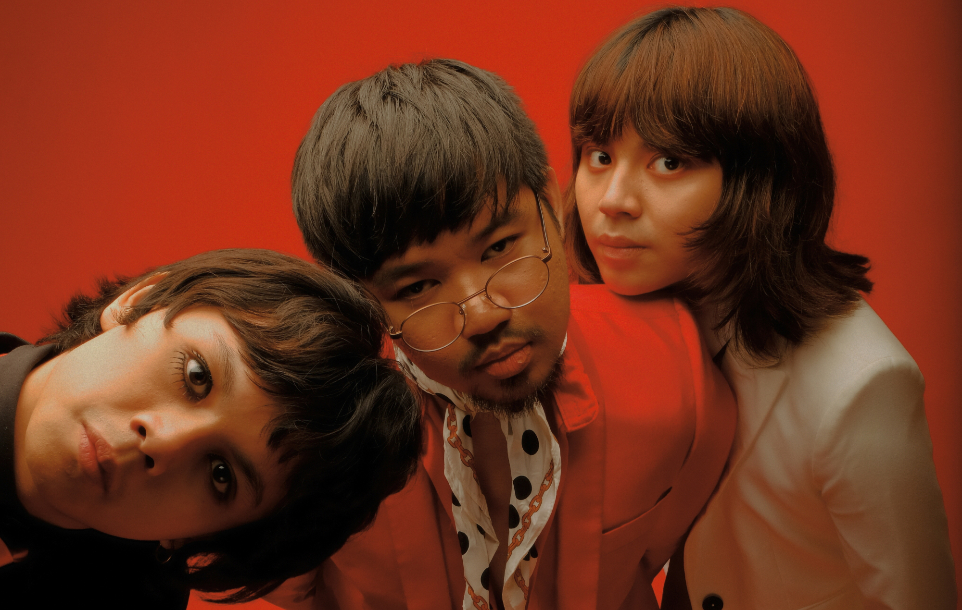

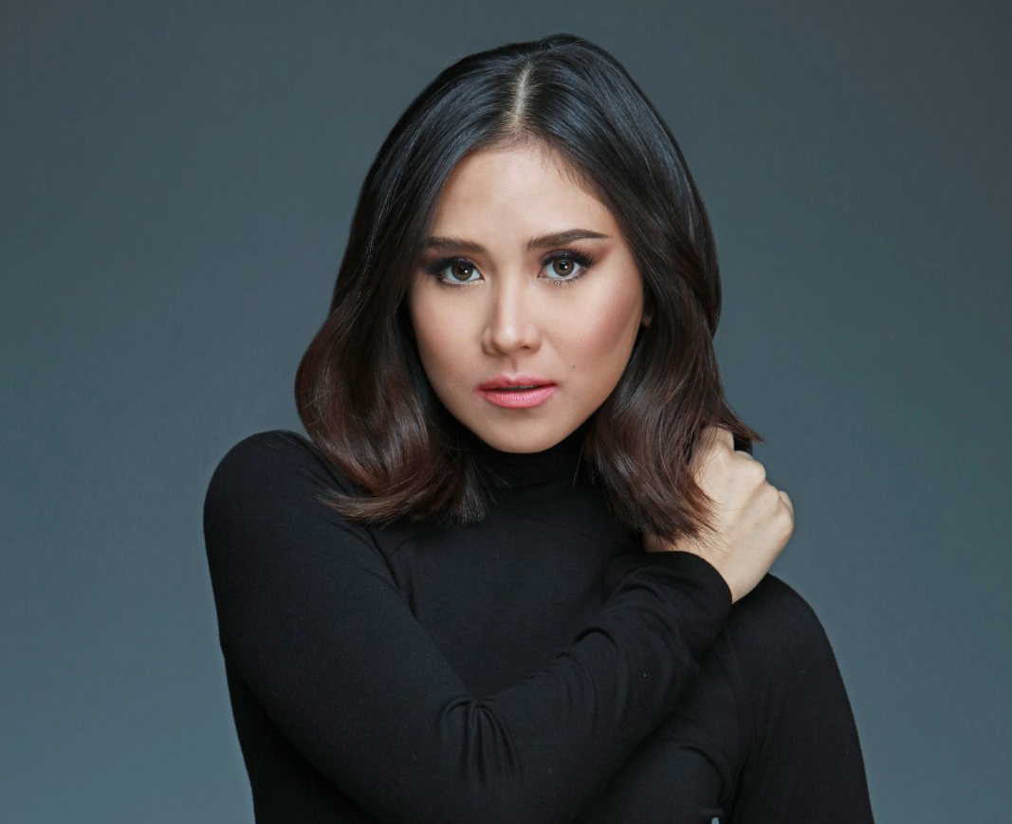

Recommended Artists (Rock)
Callalily
IV of Spades
Distance: 0.018834
Distance: 0.019697
Michael Dutchi Libranda
Sarah Geronimo
Jem Macatuno
Distance: 0.021880
Distance: 0.025097
Distance: 0.026377
Notes:
Callalily - 0.014239
IV Of Spades - 0.019697
Sara G - 0.025097
Jem Macatuno - 0.026377
Michael Dutchi Libranda -0.021880

Slide 30
Conclusion
Key Findings:
Similar to those from mainstay artists, I Belong to the Zoo’s songs generally have sad, mellow tones.
Their songs are faster and louder than those from mainstay artists.
Recommendations:
Improve song composition based on current trends
Compose sad, slower, and more silent songs.
Improve Marketing strategies
Strategically plan release of music videos
Collaborate with famous actresses/actors in music videos
Partner with producers for movie/teleserye soundtrack
Make use of popular events to promote music
Collaborate with compatible artists: Acoustic, Jazz, Rock

Slide 31

Thank you!
Spotify Playlist QR Code

Slide 32
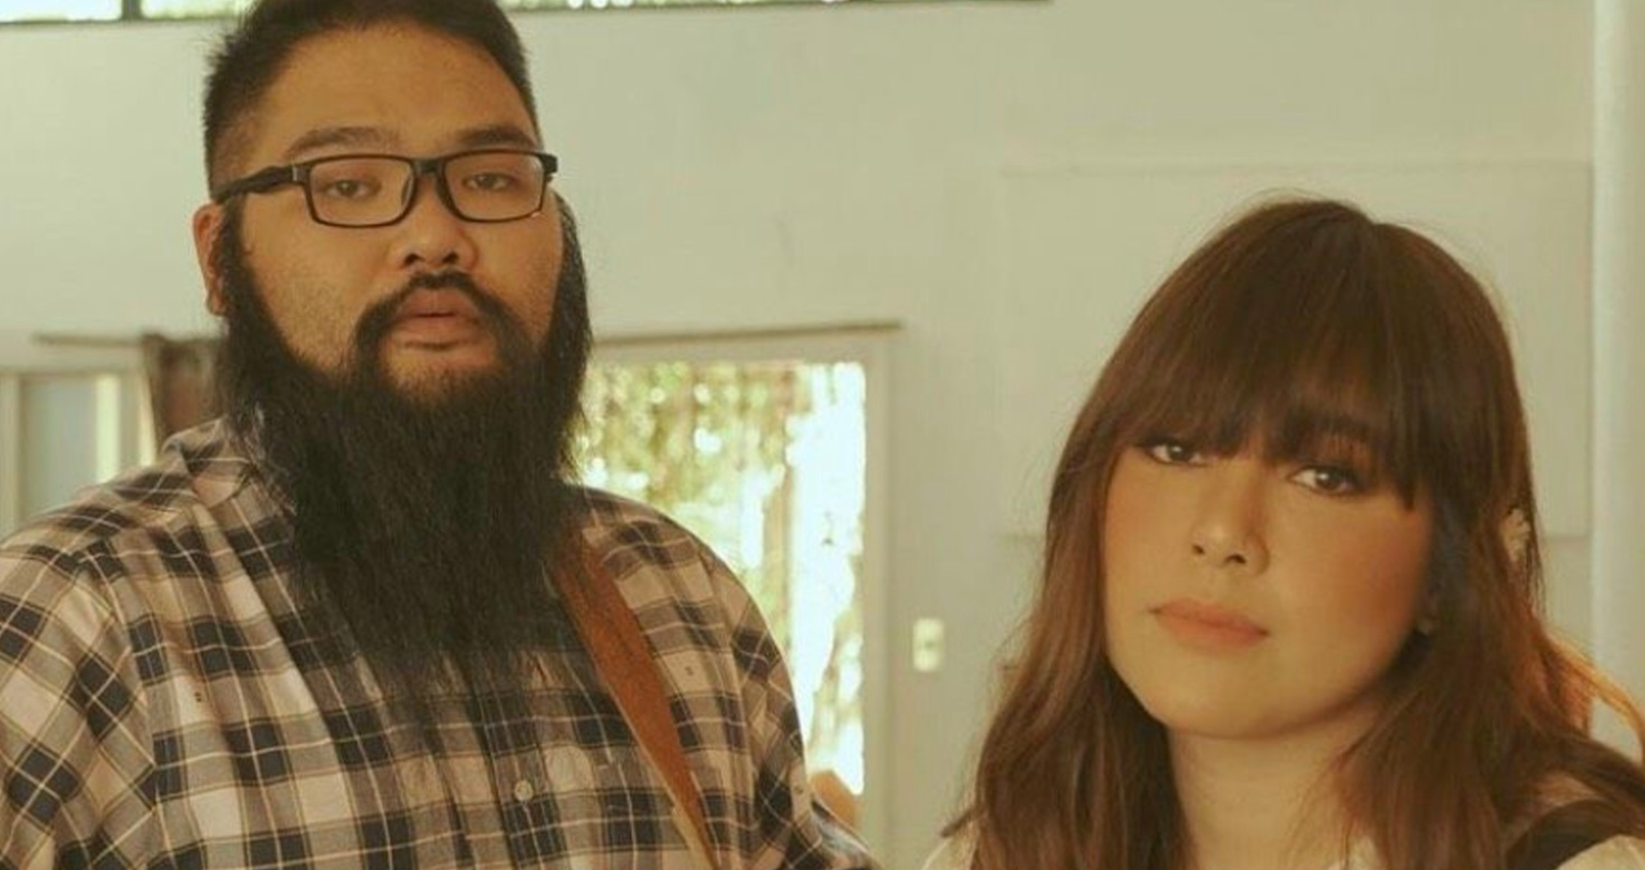
COLLAB with Other Artists (Recommendation part)

Slide 33
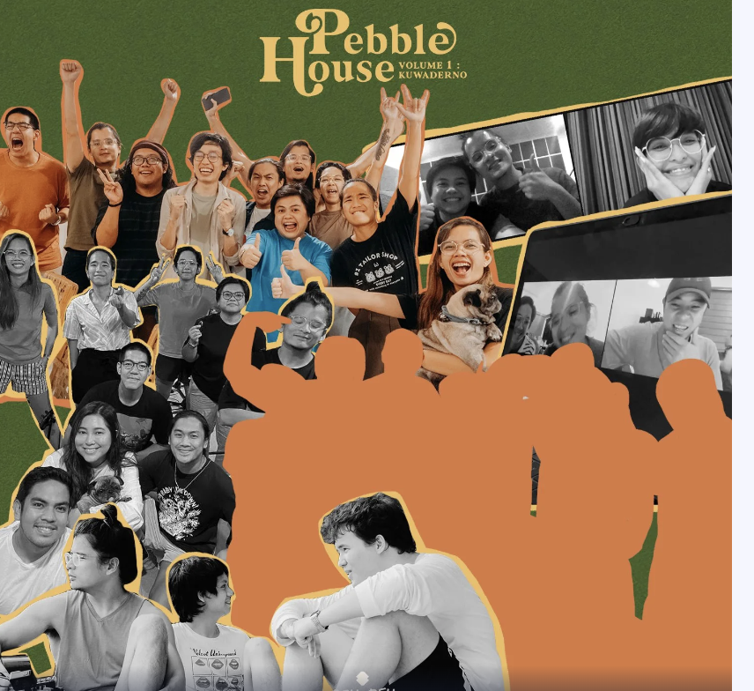
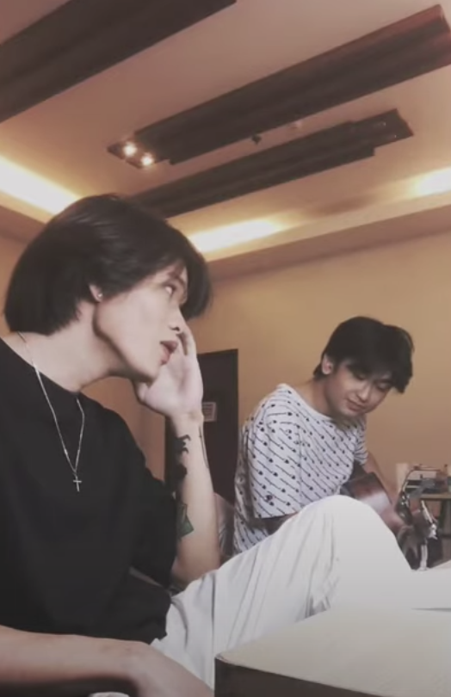
Collab
Ben&Ben, Juan Karlos, Zild, and KZ Tandingan
Adie and Arthur Nery - Paraluman
Notes:
Recommendations, collab

Slide 34
Methodology
Data Gathering and Wrangling
Data Visualization
Feature Engineering
I’ll include the outline Dhee Jee gave us
Notes:
This is where we come in, Our group aims to use data Science to help them Reach the top once again
These are our recommendations: Improve song composition based on trends from 2017 to 2022 (or current trends)

